Slide 1

Git: Version Control Demystified
Welcome! This presentation will explore the fundamentals of Git, a powerful version control system that's essential for software development and collaboration. We'll cover the basics, workflow, common commands, and best practices for working with Git effectively.

Slide 2
What is Git and Why Use It?
Version Control
Collaboration
Git helps track changes to files over time, enabling you to revert to previous versions, compare different states, and collaborate efficiently.
Git allows multiple people to work on the same project simultaneously, merging changes and avoiding conflicts.

Slide 3
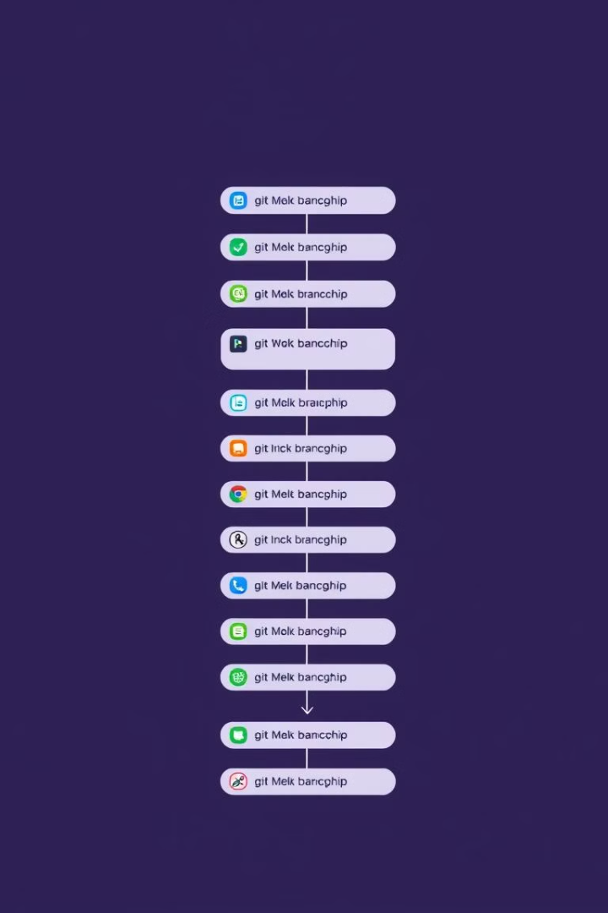
Core Concepts: Repositories, Commits, Branches
Repository
Commit
A central storage location for all project files and their history.
A snapshot of the project at a specific point in time, capturing changes made.
Branch
A separate line of development that allows for parallel work without affecting the main branch.

Slide 4
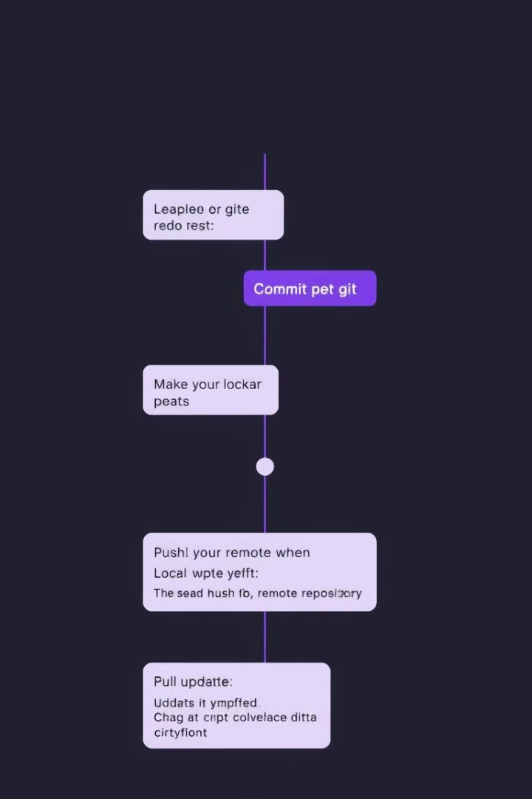
Git Workflow: From Local Changes to Remote Collaboration
1
Local Changes
Modify files within your local working directory.
2
Commit
Save your changes as a snapshot in your local repository.
3
Push
Share your commits to the remote repository.
4
Pull
Fetch and integrate updates from the remote repository to your local version.

Slide 5
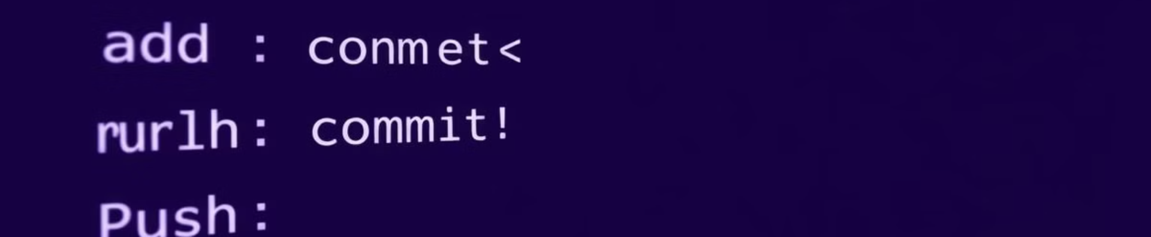




Essential Git Commands: Add, Commit, Push, Pull
git add: Stage files for commit.
git commit: Create a snapshot of your staged changes.
git push: Share your commits with the remote repository.
git pull: Fetch and integrate updates from the remote repository.

Slide 6
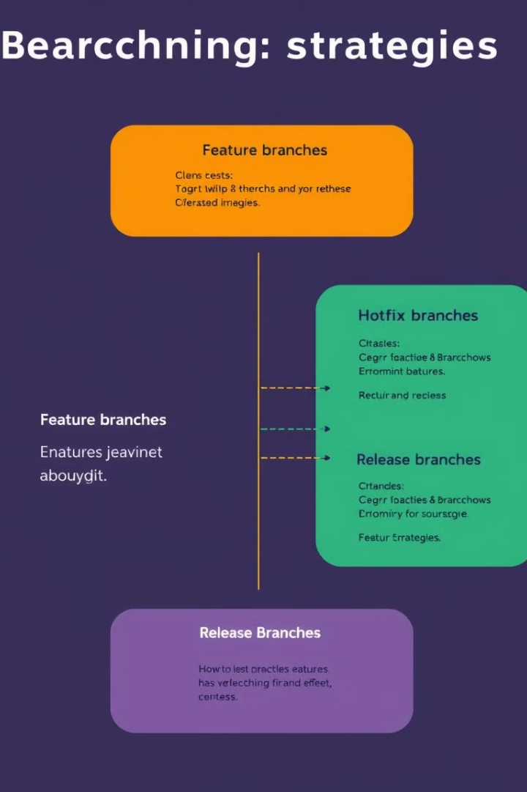



Branching and Merging Strategies
Feature Branches
Create a branch for each new feature, isolating development work.
Hotfix Branches
Quickly address critical bugs or issues without disrupting ongoing development.
Release Branches
Prepare a stable version for release, ensuring consistent code and updates.

Slide 7

Resolving Conflicts and Handling Errors
Conflict Detection
Git identifies conflicting changes when merging branches.
Manual Resolution
Review the conflicting code sections and manually resolve the differences.
Committing Changes
Commit the resolved conflicts and merge the branches.

Slide 8
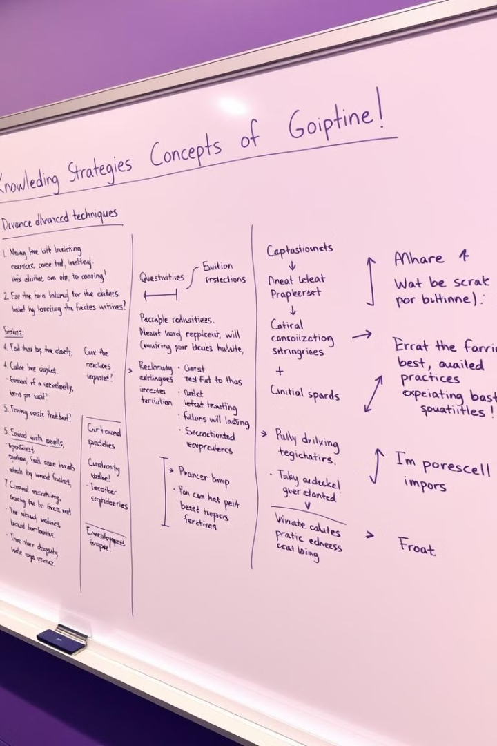
Best Practices and Advanced Git Techniques
Adopt best practices for efficient and effective Git usage, including clear commit messages, regular rebasing, and utilizing advanced features like stashing and cherry-picking.

